Slide 1
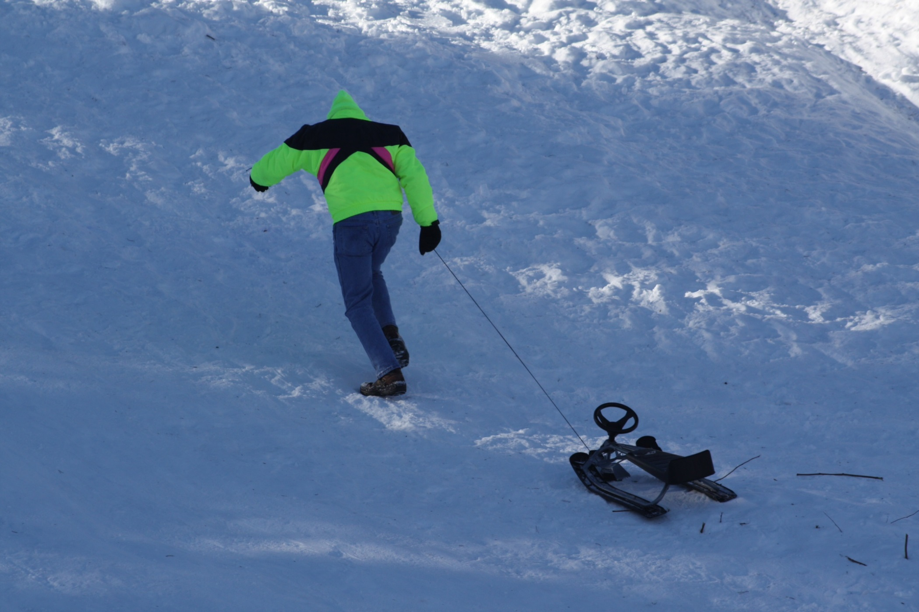
Little Gabe went up the hill, his sled he towed behind him!
Wear proper PPE!

Slide 2
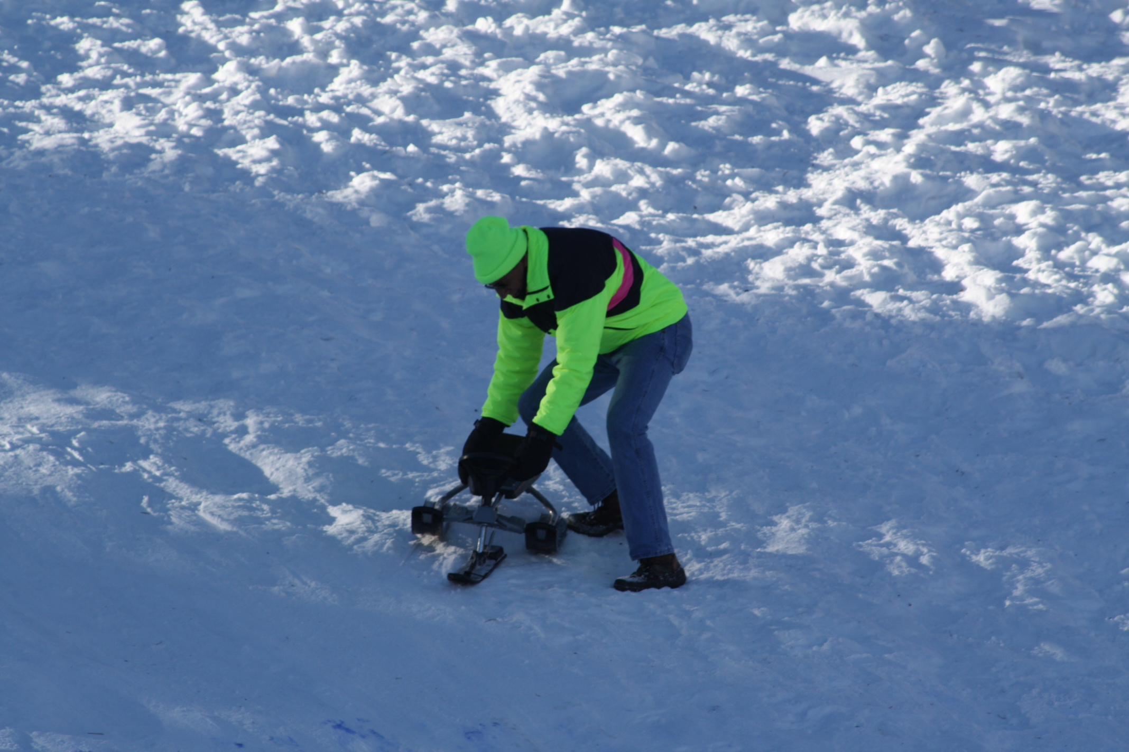
It was a brand new toy, he knew not well and there was no adult to remind him.
Know your equipment before you use it!

Slide 3
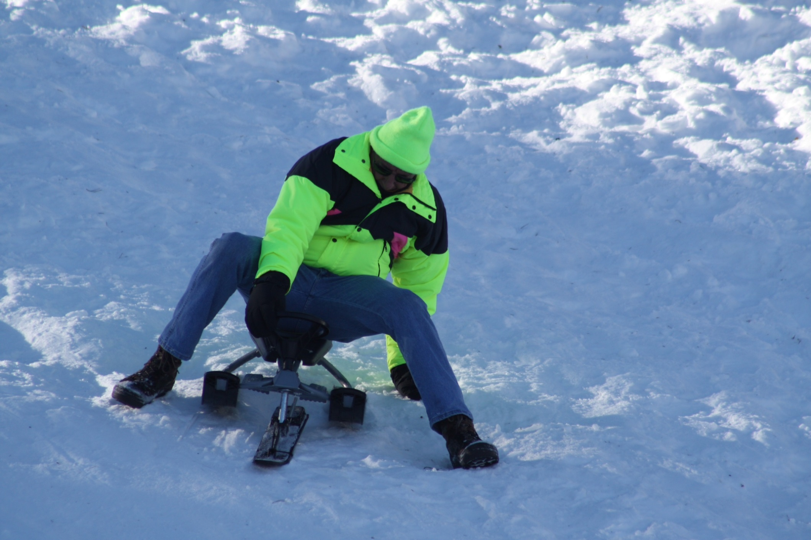
Away in a flash, Gabe flew, how fast he went he never knew.
Be sure you’re comfortable with new equipment

Slide 4
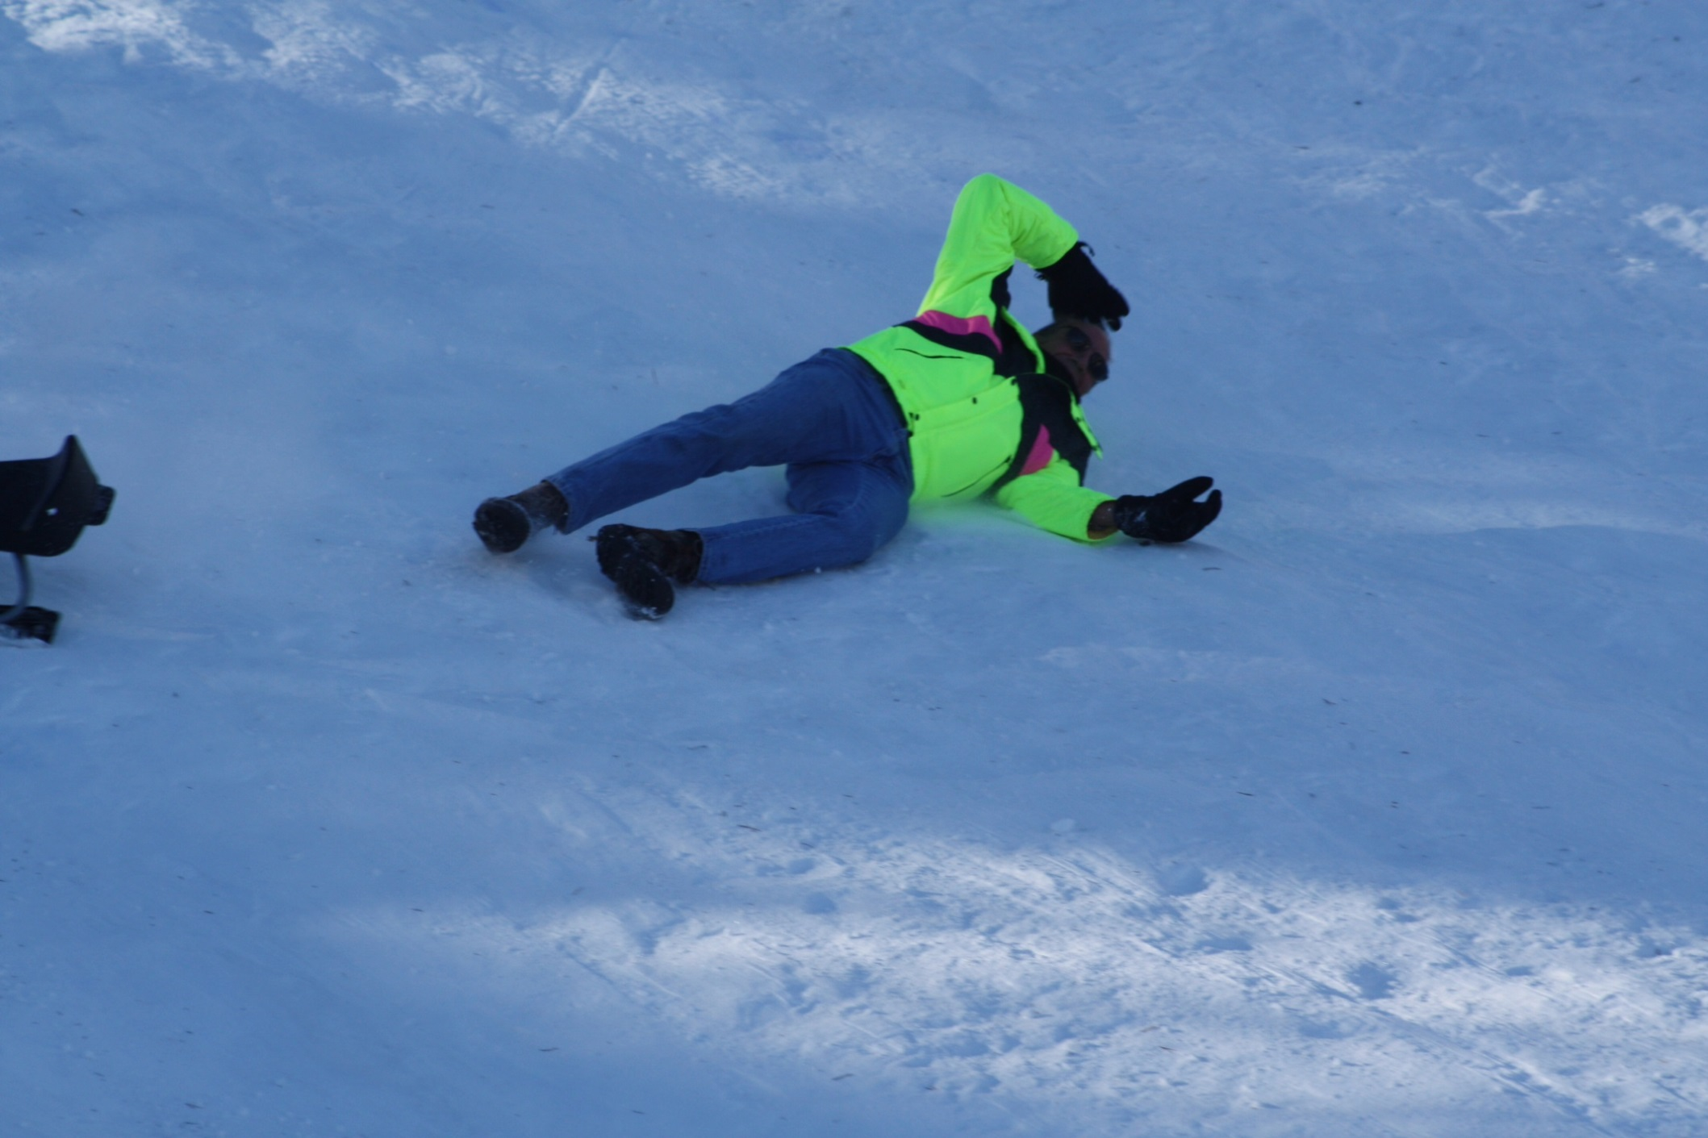
Gabe fell down, he saved his crown, his butt’s another matter!
Coordination strikes every ten seconds! Be ready next time, Gabe!!!!
*No animals were harmed during the making of this presentation!

